Slide 1
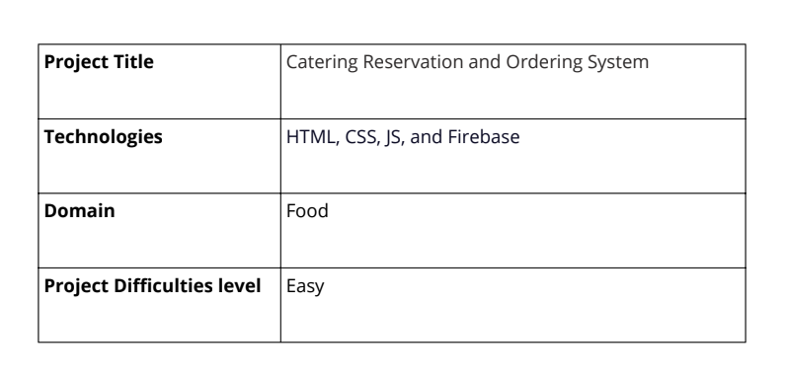
PROJECT 2(Advance) -Catering Reservation and Ordering System
-SUBMITTED BY
POOJA V K

Slide 2
abstract
Online Food Ordering System is proposed for simplifies the food ordering process. The system displays a user interface through update of the menu, the available options, it easily oversees the work for the customers. Customers can select more than one item to create an order and may view the details of the order before logging off. The order confirmation will be sent to the customer. The order is placed in the queue, updated in the Database, and returned in real-time. This system helps the staff to deal with the order in real-time and process it effectively. Online food order system is mainly designed primarily function for use in the food delivery industry. This system will allow hotels and restaurants to increase online food ordering such type of business. All these orders can be made on the selection of food menu items just within minutes a few minutes. In the idealistic concept of the modern food industry, the service delivery may be quick and convenient when the delivery place region is at the customer's region. All these orders are operated by the restaurant employees, through an easy graphic interface of the operator, for the faster and convenient processing.

Slide 3
introduction
The Online Ordering System can be defined as a simple and convenient way for customers to purchase food online, without having to go to the restaurant. This system is enabled by the internet – it is the internet that connects the restaurant or the food company on one hand, and the customer on other hand.
Therefore, as per this system, the customer visits the restaurant’s website, browses through the various food items available there and goes ahead and selects and purchases the items he or she needs . These items will then be delivered to the customer at his or her doorstep at the time they choose by a delivery person.
Payments for such online orders can be made through debit cards, credit cards, cash or card on delivery, or even through digital wallets. This system for online food delivery is completely safe, secure and is a very popular method that is revolutionizing the way in which the food industry operate. Here we Propose an “Online Food Ordering System” that has been Designed for Fast Food restaurant, Take-Out or College Cafeterias. The system can also be used in any food delivery industry. This simplifies the process of food ordering for both the customer and the restaurant, as the entire process of taking orders is automated. The main advantage of my system is that it greatly simplifies the ordering process for both the customer and the restaurant. When the customer visits the ordering webpage, they are presented with an interactive and up-to-date menu, complete with all available options and dynamically adjusting prices based on the selected options. After making a selection, the item is then added to their order, which the customer can review the details of at any time before checking out.

Slide 4
Problem statement
Catering is a website that allows counter developers to promote and sell their catering. Rural towns would be able to sell their commodities to the rest of the globe as a result of this.
The goal of this project is to establish a portal that will allow users to buy catering from the admin and change product information securely using a mobile device. Catering is given priority in order to allow them to develop their skills and promote our traditional Indian culture.

Slide 5
objectives and goals
The proposed system is to be used for the management of ordering activities in fast food restaurants. It facilitates the process of recording orders that customers have placed. The system shall cover the following functions in order to support the restaurant's business process to achieve the objectives:
It should provide order-making functionality for the customer, display the order, allow changes before placing an order, and permit payment using a prepayment card, credit card, or debit card.
The graphical user interface should display a section that may contain promotions and menu items.
Avoid the interface that brings out customers' orders detail to the front-end and kitchen staffs for delivering customers' orders .
Any tools that can generate reports for making decisions .
A tool that allows the management to change food information such as price, a new menu, and many others, tools for user, system menu, and promotion records management.

Slide 6
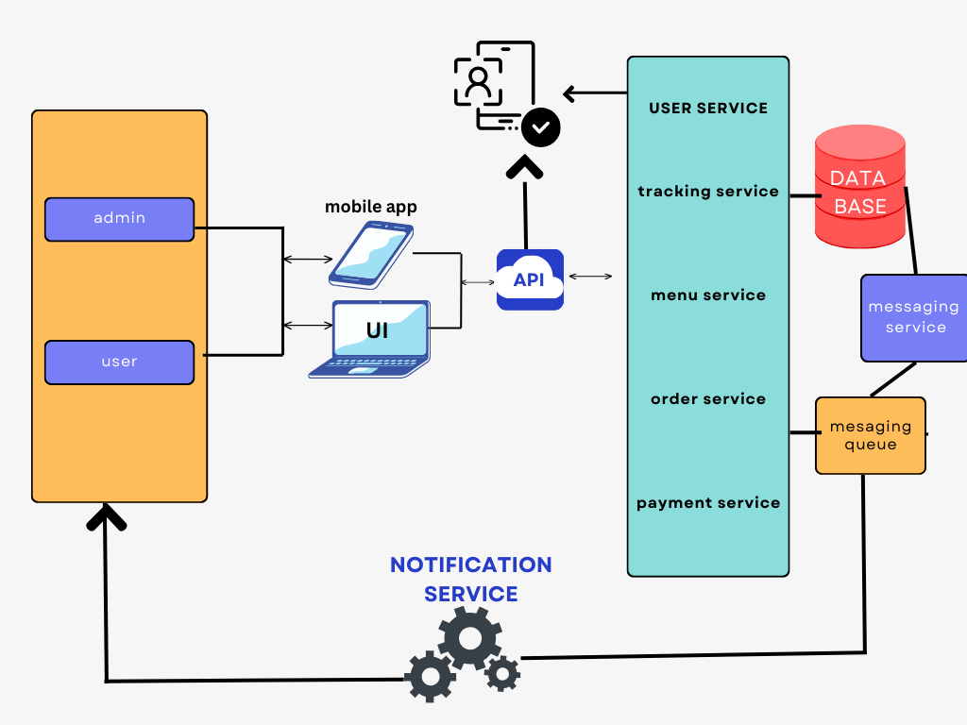
Architecture

Slide 7
OUTPUT SCREEN
PAGE 1
1.HTML Structure:
The document is structured with a <!DOCTYPE html> declaration and proper HTML tags including <html>, <head>, and <body>.
The head section includes metadata, title, and CSS for styling.
The body contains the main content: a div for the selection container with buttons for registering as a user or admin.
2.CSS Styling:
The body has a background image, is centered, and uses a flexbox layout to align the content.
selection container is styled with padding, borders, rounded corners, and a shadow effect to make it stand out.
Buttons are styled for a modern look with hover effects.
3.JavaScript Functionality:
A JavaScript function redirect To Registration is defined to handle the button clicks and redirect to the appropriate registration page
based on the user's selection.

Slide 8
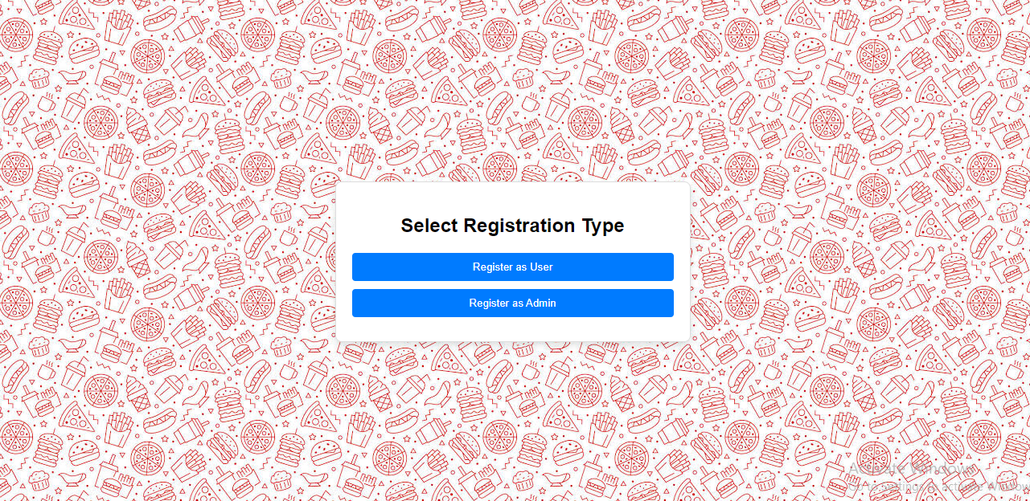

Slide 9
Key Points:
Responsive Design:
The page will look good on different screen sizes due to the flexible layout and responsive design practices.
User Experience:
The clear buttons and instructions make it easy for users to select their registration type.
JavaScript:
The script is simple and effective for redirecting users based on their selection .This setup should work seamlessly in a typical web environment, helping users navigate to the correct registration page based on their role.

Slide 10
IF USER CHOOSE THE REGISTER AS USER:
PAGE 2.1 [USER REGISTER PAGE]:
1.HTML Structure:
The document is structured with a <!DOCTYPE html> declaration and proper HTML tags including <html>, <head>, and <body>.
The head section includes metadata, title, and CSS for styling.
The body contains the main content: a div for the registration container with input fields for first name, last name, email, and password, and
a submit button.
2.CSS Styling:
The body has a background image, is centered, and uses a flexbox layout to align the content.
The container is styled with padding, borders, rounded corners, and a shadow effect to make it stand out.
Input fields and buttons are styled for a modern look with hover effects.
3.JavaScript Functionality:
A JavaScript function is added to handle form submission, save user details to localStorage, and redirect to the home page.

Slide 11
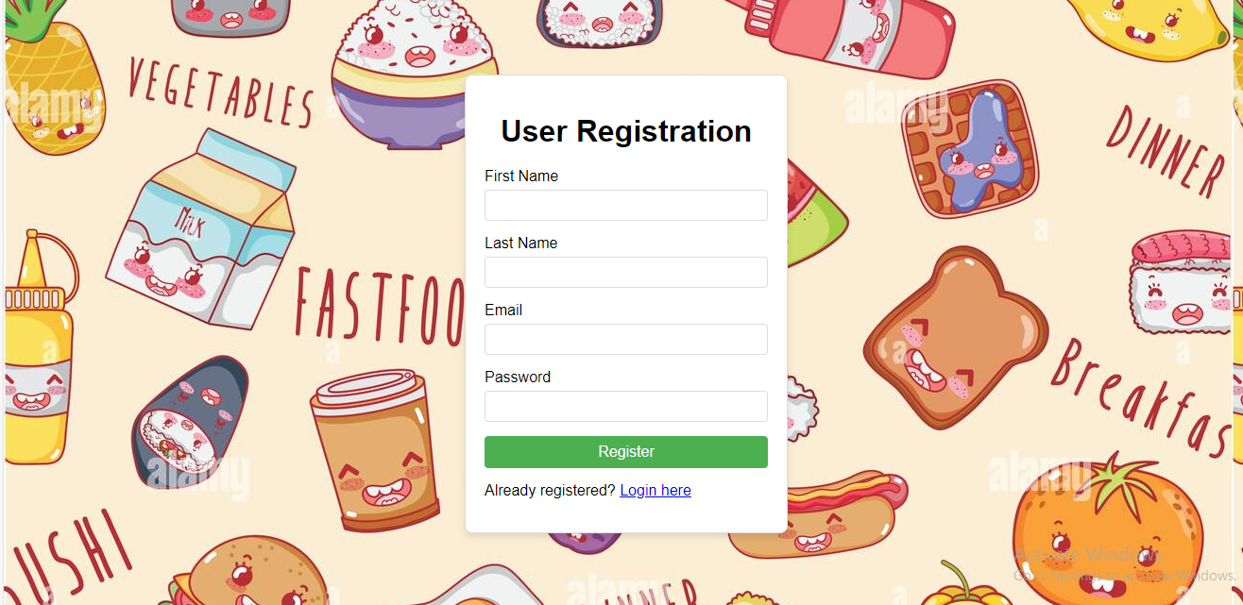

Slide 12
Key Points:
Responsive Design:
The page looks good on different screen sizes due to the flexible layout and responsive design practices.
User Experience:
Clear form fields and instructions make it easy for users to register.
JavaScript:
The script effectively handles form submission, saving data to loca lStorage, and redirecting users after registration.

Slide 13
PAGE 2.2 [USER LOGIN PAGE]:
1.HTML Structure:
The document starts with a proper <!DOCTYPE html> declaration.
Metadata, title, and CSS for styling are included in the head section.
The body contains the main login form with input fields for email and password and a submit button.
2.CSS Styling:
The body is styled to have a background image, centered content, and a flexbox layout.
The container is styled with padding, borders, rounded corners, and a shadow effect.
Input fields and the submit button are styled for a modern look with hover effects.
3.JavaScript Functionality:
The form submission is handled using JavaScript to prevent the default form submission behavior.
User details are retrieved from local Storage and compared with the entered email and password.
If the login details match, the user is redirected to the home page. If not, an alert is shown.

Slide 14
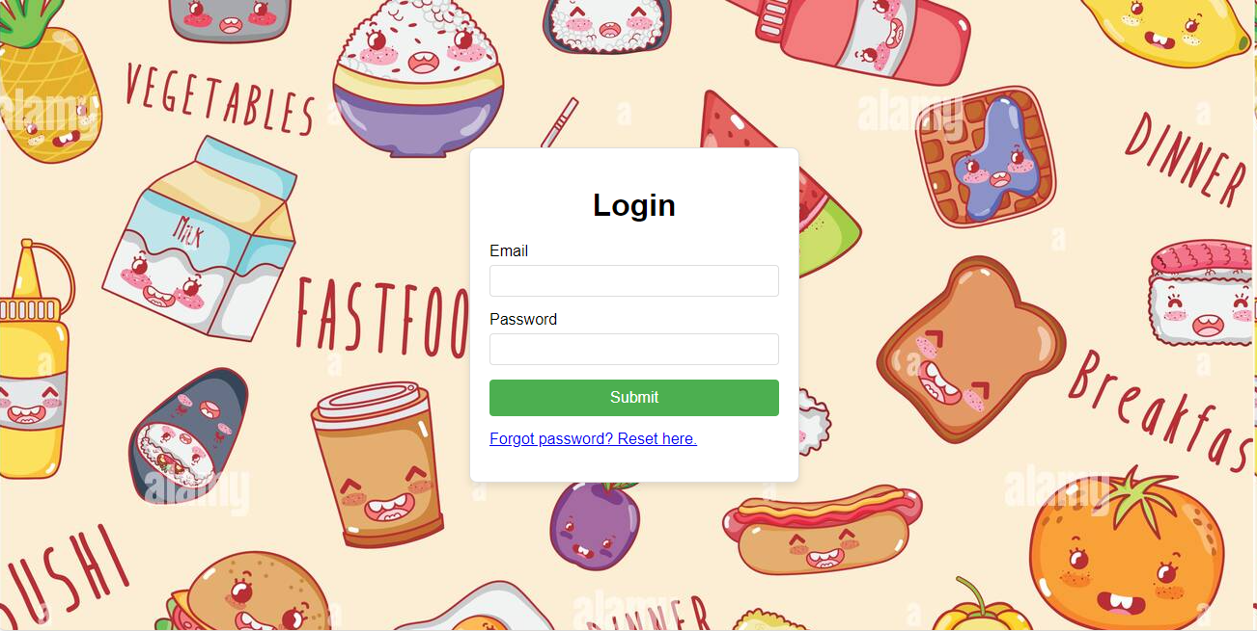

Slide 15
Additional Notes:
Ensure the image path img/user.jpeg is correct and the image is available in your project directory.
The local Storage mechanism assumes user registration details are stored in local Storage. Ensure this mechanism aligns with your registration
process.
The login link for resetting the password is included for better user experience.
PAGE 2.3[USER PASSWORD RESET PAGE]:
1.HTML Structure:
The document begins with a <!DOCTYPE html> declaration.
The head section contains metadata, a title, and embedded CSS for styling.
The body contains a container div with a form for resetting the password.
2.CSS Styling:
The body is styled to have a background color, centered content, and a flexbox layout.
The container div is styled with padding, borders, rounded corners, and a shadow effect.
Input fields and the submit button are styled for a modern look with hover effects.
Additional classes for messages (message and error-message) are included for displaying feedback.
3.JavaScript Functionality:
The form submission is handled using JavaScript to prevent the default form submission behavior.
A simulated asynchronous request is implemented using setTimeout to mimic the behavior of a real request.
User email is checked against a simulated stored email. If the email matches, a success message is displayed; otherwise, an error message is
shown.

Slide 16
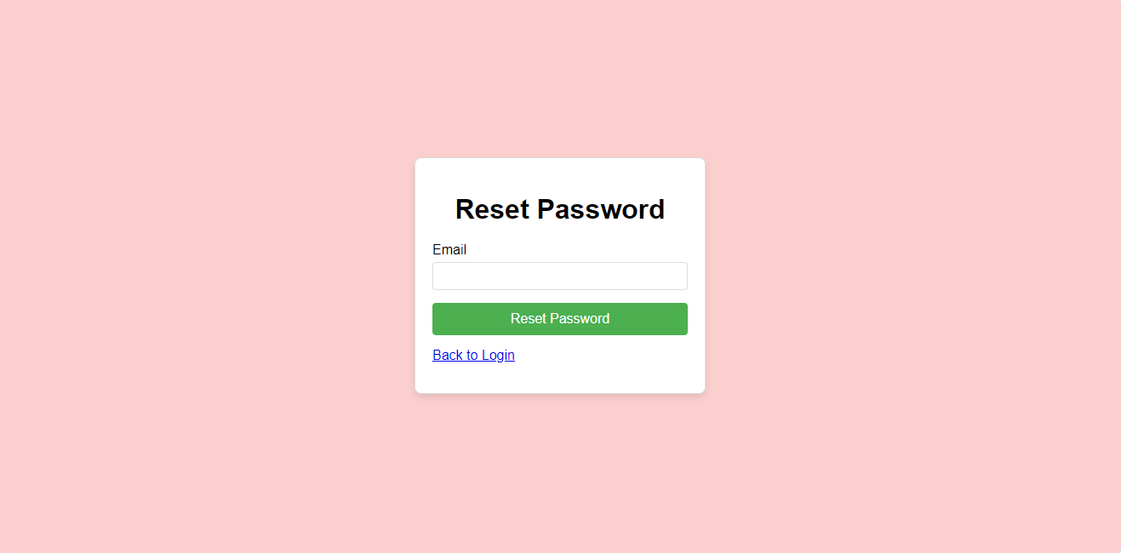

Slide 17
PAGE 2. 4 [USER HOME PAGE]:
1.HTML Structure:
The head section contains metadata, the title, and embedded CSS.
The body contains a container with a welcome message, user profile section, navigation link, and logout button.
2.CSS Styling:
The body is styled to have a full-screen background image, centered content, and a flexbox layout.
The container is styled with text alignment, color, and spacing.
The user profile section has a border, padding, and a semi-transparent background for better readability against the background image.
The navigation link and logout button have consistent styling with hover effects.
3.JavaScript Functionality:
The DOM Content Loaded event is used to retrieve and display the user's profile information from local Storage.
A logout function is provided to clear local Storage and redirect the user to the registration page.

Slide 18
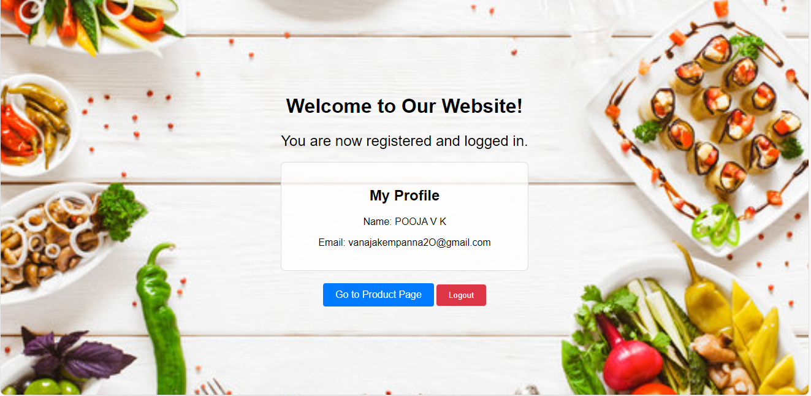

Slide 19
PAGE 2. 5 [USER VIEW PRODUCT PAGE]:
1.CSS Styling:
Enhanced the layout and styling for a modern look.
2.JavaScript:
Optimized the script to handle adding and removing products from the cart, updating the total cost, and showing notifications.
3.HTML Structure:
Ensured semantic HTML for better readability and maintenance.
Explanation:
Initialize Cart UI on Page Load:
The initialize Cart UI function checks for existing items in the cart and updates the UI accordingly.
Clear Cart on Page Load:
The window.onload function clears the cart and total cost when the page loads, ensuring a fresh start each time.
Notification Customization:
A simple showNotification function using alert is used. You can replace it with a more customized notification system if needed.
Error Handling:
Basic handling to ensure the operations are executed correctly.

Slide 20
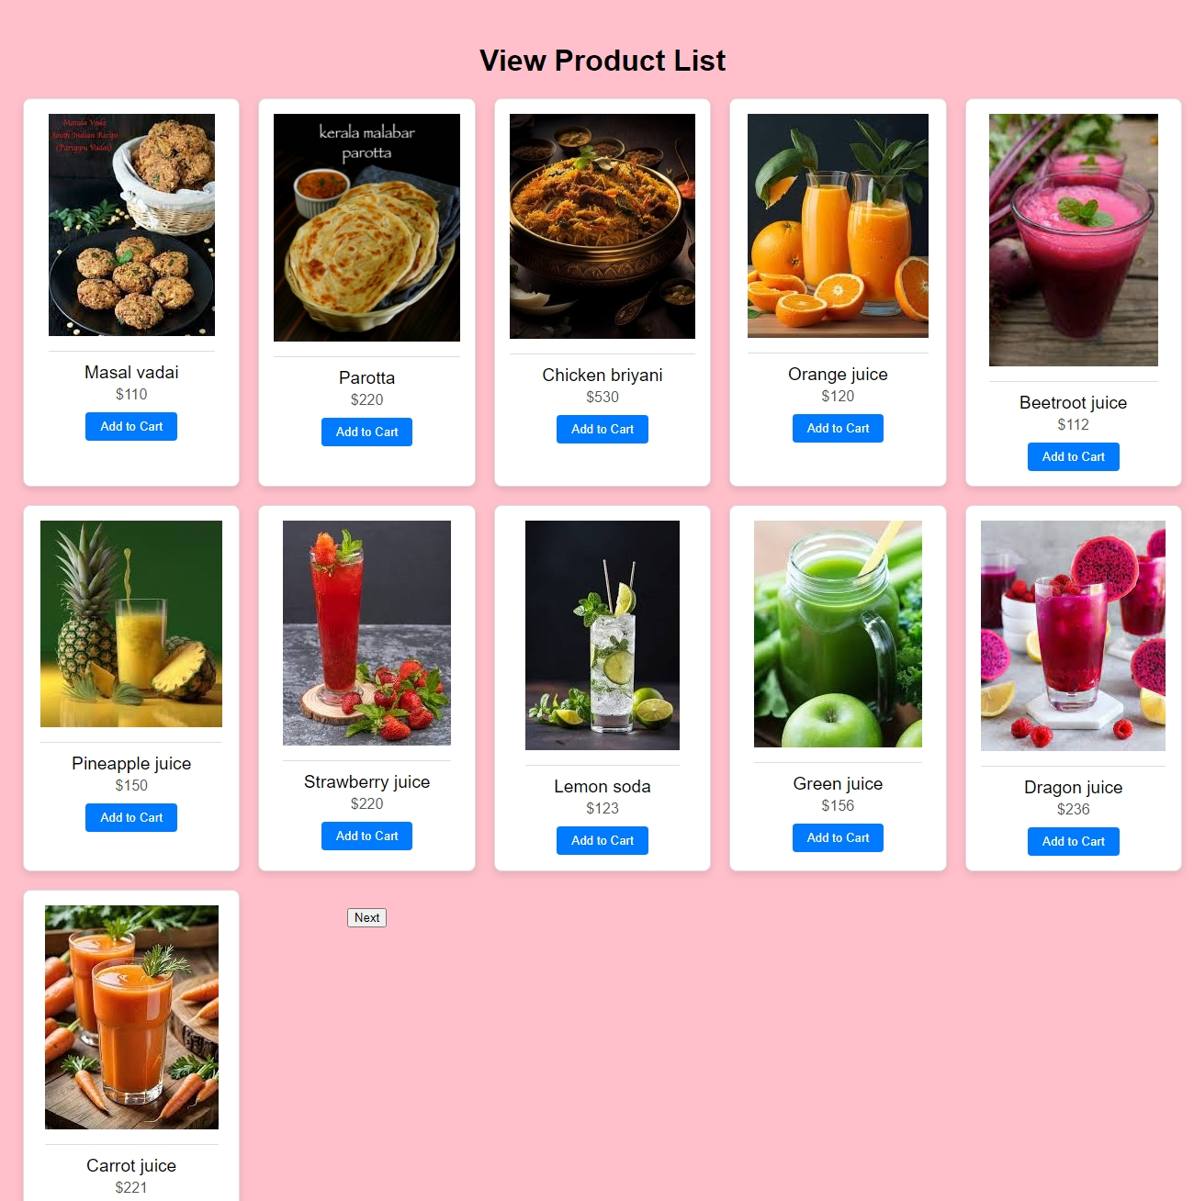
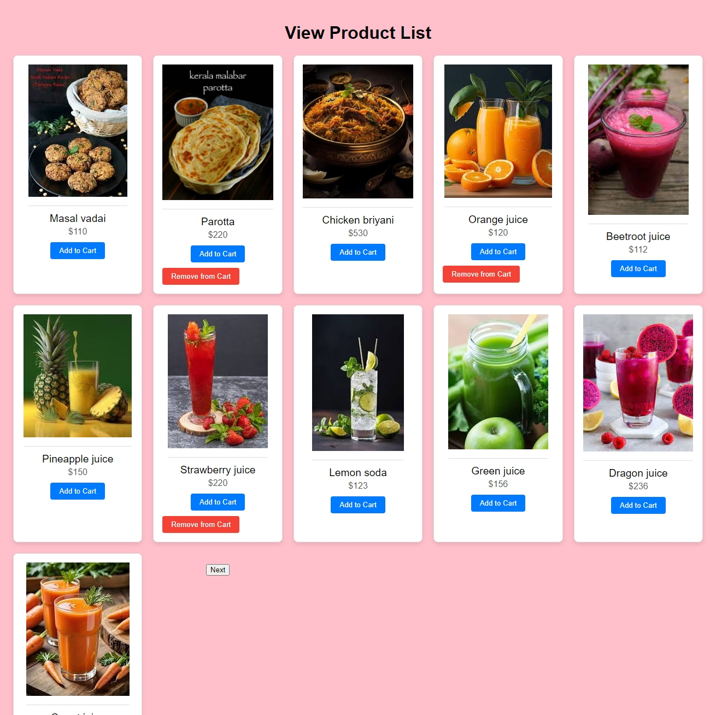

Slide 21
PAGE 2. 6 [MY ORDER PAGE]:
1.HTML Structure:
Document Type: Declares the document type as HTML5 (<!DOCTYPE html>).
Language: Specifies the language of the document (<html lang="en">).
Meta Tags: Sets character encoding and viewport for responsive design.
Title: Displays "My Order" as the title in the browser tab.
Body Content:
Heading: <h1> centered using inline CSS for main title.
Order Details Container: <div class="order-details"> for displaying dynamically added order items.
Total Cost Display: <div class="total-cost"> shows the total cost fetched from localStorage.
Next Button: <div class="center-button"> contains a button linked to "place order.html" for proceeding to the next step.
2.CSS:
Body Styling: Sets font family, background color, and padding.
Order Details Styling: Defines styles for the order details container (max-width, margin, background-color, border, border-radius, padding,
box-shadow).
Order Item Styling: Configures layout for each order item (display: flex, align-items: center, border-bottom, padding).
Total Cost Styling: Aligns total cost to the right (text-align: right, font-size).
Button Styling: Centers the button (text-align: center, margin-top).

Slide 22
3.JavaScript:
Load Order Details Function:
Retrieves orderDetails and totalCost from localStorage.
Constructs HTML for each item dynamically using template literals.
Inserts the generated HTML into .order-details.
Updates the total cost displayed in totalCostElement.
Window.onload Event:
Calls loadOrderDetails() when the page finishes loading to populate order details.
Summary:
HTML provides structure and content for displaying order details and total cost.
CSS styles elements to enhance visual presentation and layout.
JavaScript adds dynamic functionality to load and display order details from localStorage.

Slide 23
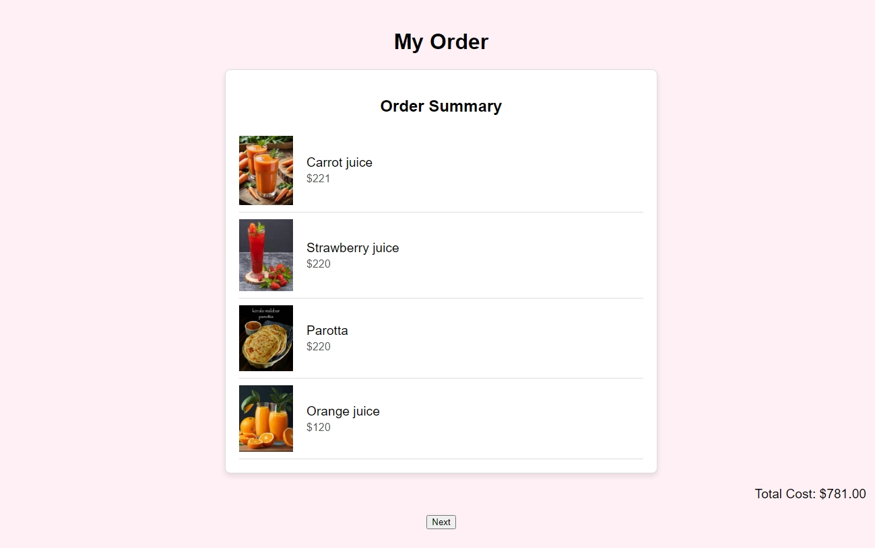

Slide 24
PAGE 2. 7 [PLACE ORDER PAGE]:
1.HTML Structure:
Declares HTML5 document type and sets language to English.
Defines meta tags for character encoding and viewport settings.
Provides a title for the page as "Place Order".
2.Styling (CSS):
Sets a consistent font family, background color, and padding for the body.
Styles the order details container (order-details) with a centered heading, bordered box, and shadow for visual appeal.
Formats each order item (order-item) with flexbox for alignment and spacing.
Aligns total cost (total-cost) to the right with a specified font size.
Styles customer details inputs and selects (customer-details) with consistent padding, borders, and margins for a uniform appearance.
Customizes the "Place Order" button (center-button button) with background color, text color, padding, border radius, and hover effect.
3.JavaScript Functionality:
Loads order details dynamically from localStorage (loadOrderDetails() function).
Populates the order summary section and updates the total cost.
Validates customer inputs (placeOrder() function) for name, email, address, and payment method selection.
Alerts the user upon successful order placement, clears localStorage data, and redirects to 'web.html' for further processing.

Slide 25
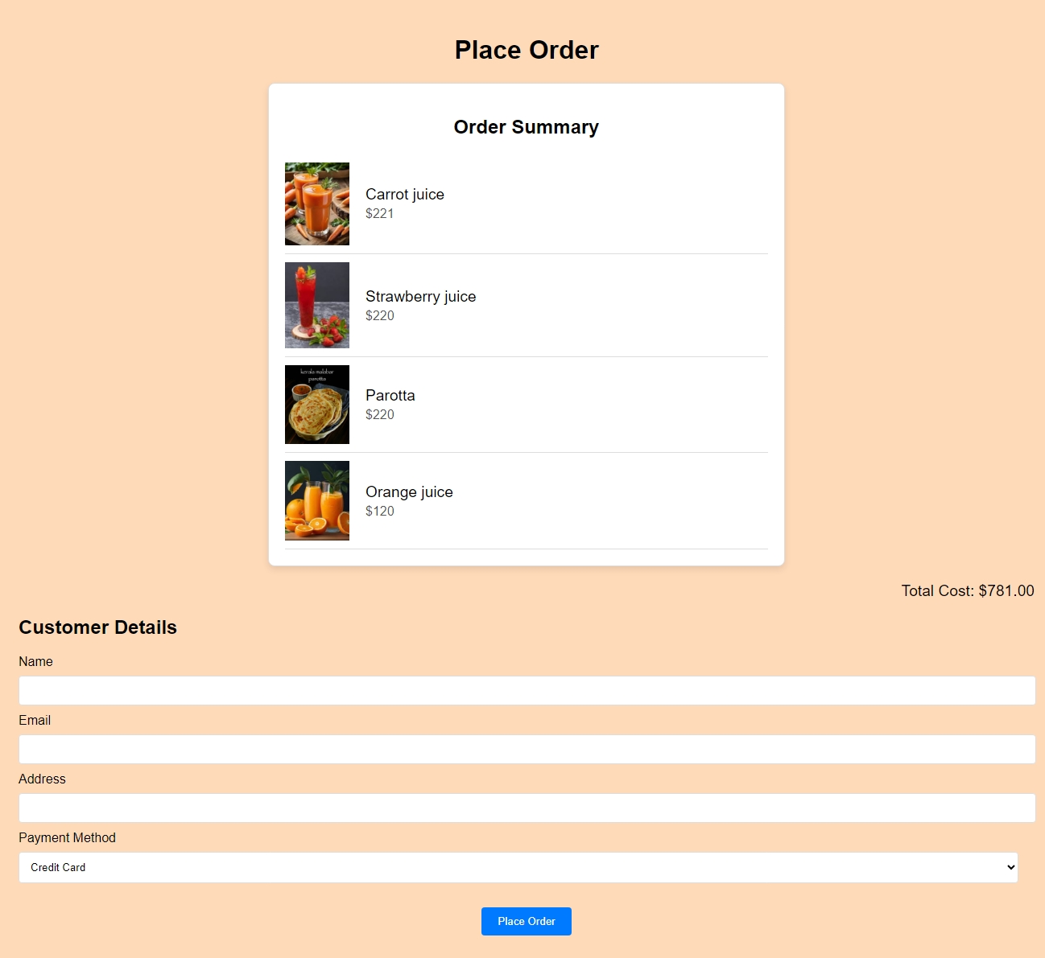
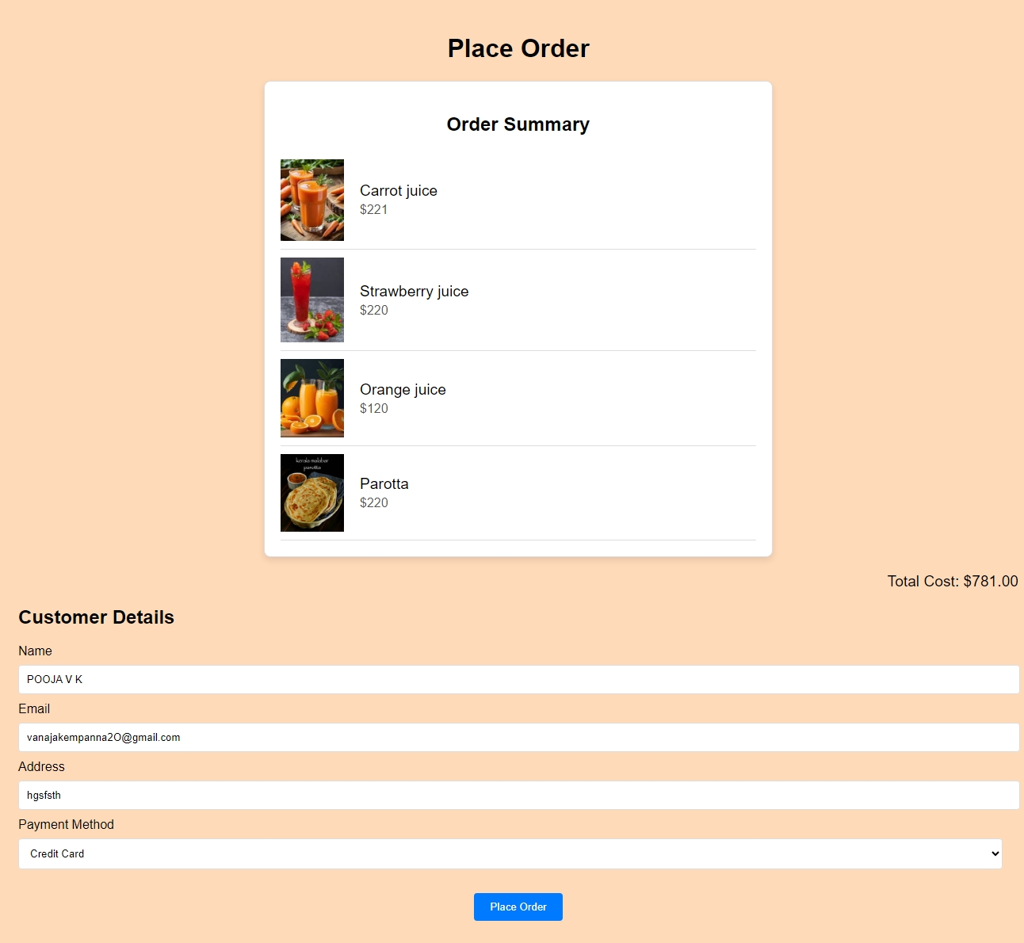

Slide 26
PAGE 3. 1 [ADMIN REGISTER PAGE]:
1.HTML Structure:
Includes essential meta tags for character set and viewport settings.
Defines a title and links external CSS for styling and JavaScript for functionality.
2.Styling (CSS):
Applies a light background color and a centered background image to the entire body.
Uses flexbox to center-align and vertically align the registration form (container), creating a visually appealing layout.
Styles form elements (form-group) with consistent padding, borders, and rounded corners for a neat appearance.
Customizes the submit button (input[type="submit"]) with a green background and hover effect for user interaction.
3.Form (HTML):
Contains input fields for username, email, and password within a structured form (adminRegistrationForm).
Includes a submit button to finalize registration and a link (login-link) to redirect to the admin login page if already registered.
4.JavaScript Functionality:
Prevents the default form submission behavior (addEventListener).
Retrieves user input for username, email, and password.
Stores admin registration data securely in localStorage as JSON.
Redirects the user to 'admin home.html' upon successful registration for further interaction.

Slide 27
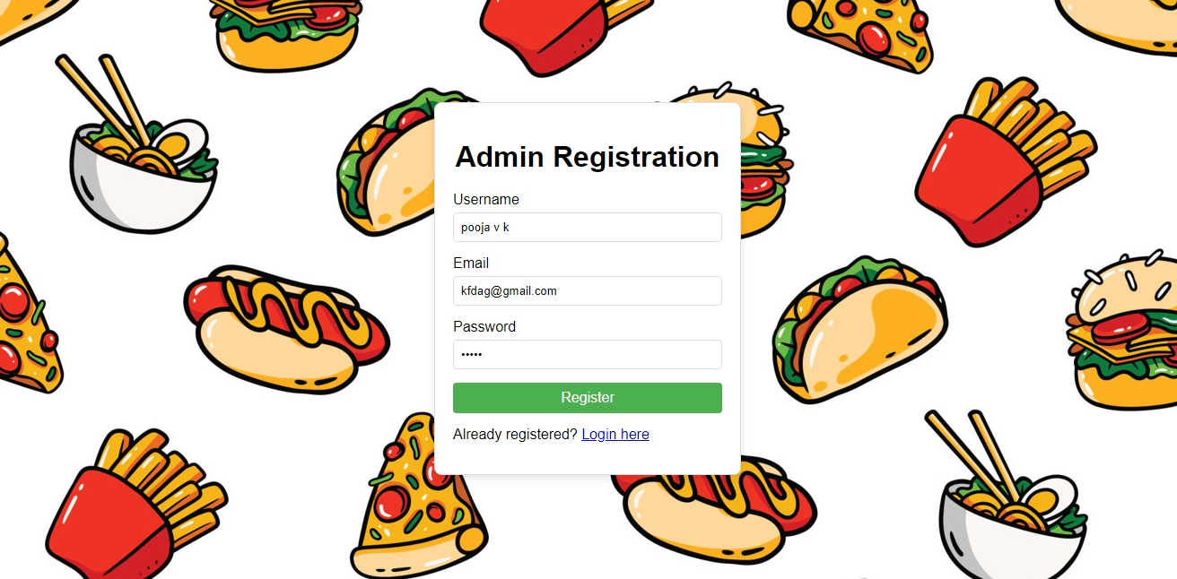

Slide 28
PAGE 3. 2 [ADMIN LOGIN PAGE]:
1.HTML Structure:
Defines the necessary meta tags for character set and viewport settings.
Sets a title and links external CSS for styling and JavaScript for functionality.
2.Styling (CSS):
Applies a centered background image and light background color to the body for aesthetic appeal.
Uses flexbox to center-align and vertically align the login form (container), ensuring it remains visually balanced on different screen sizes.
Styles form elements (form-group) with consistent padding, borders, and rounded corners for a clean appearance.
Customizes the login button (input[type="submit"]) with a blue background and hover effect for user interaction.
3.Form (HTML):
Includes input fields for username and password within a structured form (adminLoginForm).
Utilizes a submit button to initiate the login process and a link (register-link) to redirect to the admin registration page if not already registered.
4.JavaScript Functionality:
Prevents the default form submission behavior (addEventListener).
Retrieves user input for username and password.
Simulates authentication logic (replace with actual backend integration), redirecting to 'admin home.html' upon successful login or displaying an
error message for invalid credentials.

Slide 29
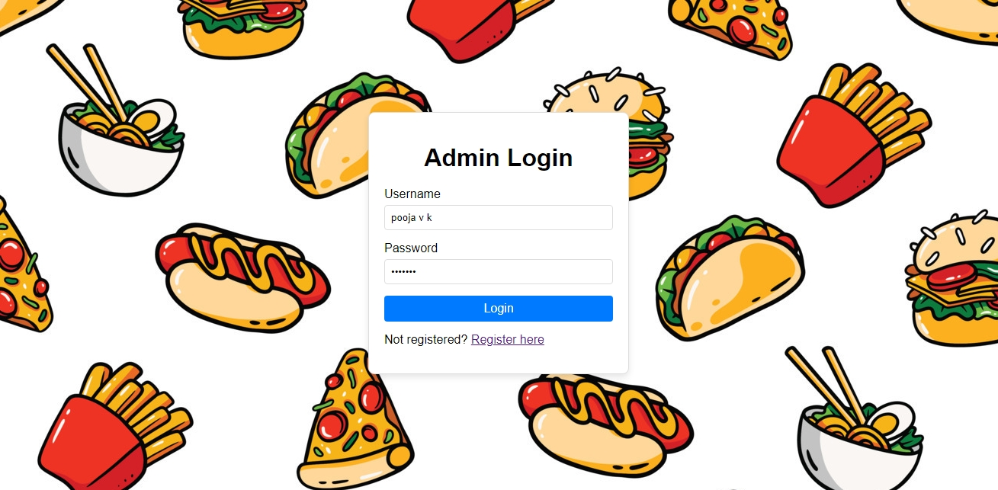

Slide 30
PAGE 3. 3 [ADMIN HOME PAGE]:
1.HTML Structure:
Defines meta tags for character set and viewport settings.
Sets a title and links external CSS for styling and JavaScript for interactive features.
2.Styling (CSS):
Utilizes a centered background image and light background color to maintain a professional and visually appealing backdrop.
Uses flexbox to center-align and vertically align content (container), ensuring it scales appropriately across different devices.
Styles elements with consistent padding, borders, shadows, and rounded corners for a polished appearance.
Customizes navigation links (navigation-link) and logout link (logout) with hover effects for intuitive user interaction.
3.Content and Functionality (JavaScript):
Retrieves admin profile data from localStorage upon page load and dynamically inserts it into the designated area (profileInfo).
Provides a direct link (navigation-link) to upload products and a logout option (logout) that removes admin credentials from localStorage and
redirects to the admin registration page (admin register.html).
Implements redirection to the admin login page (admin login.html) if no admin data is found in localStorage, ensuring security and user
management.

Slide 31
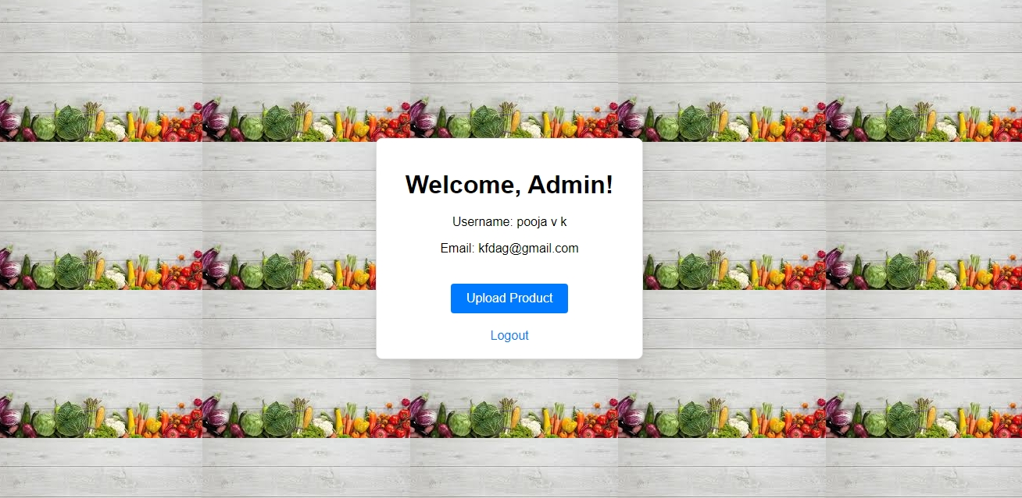

Slide 32
PAGE 3. 4 [UPDATE PRODUCT PAGE]:
1.HTML Structure and Styling:
Uses a simple layout with centered content (content-box) on a light gray background (body) for readability and focus.
Form elements (form) are styled with adequate spacing (margin-bottom and padding) and responsive design (max-width).
2.Form Elements:
Includes inputs for product name (productName), cost (productCost), and image URL (productImage), each with appropriate validation attributes
(required, min, type).
3.Buttons:
Provides two buttons within the form: "Add Product" (submit) triggers form submission for database entry, and "Next" (button) directs admins to
view orders.
4.Firebase Integration (JavaScript):
Initializes Firebase SDK with configuration (firebaseConfig) and sets up Firestore (db) for database operations.
Event listener (addEventListener) on form submission captures and validates product details before asynchronously adding them to the Firestore
collection named "products".
Alerts and console messages provide feedback on successful or failed product additions, ensuring smooth user interaction and error handling.

Slide 33
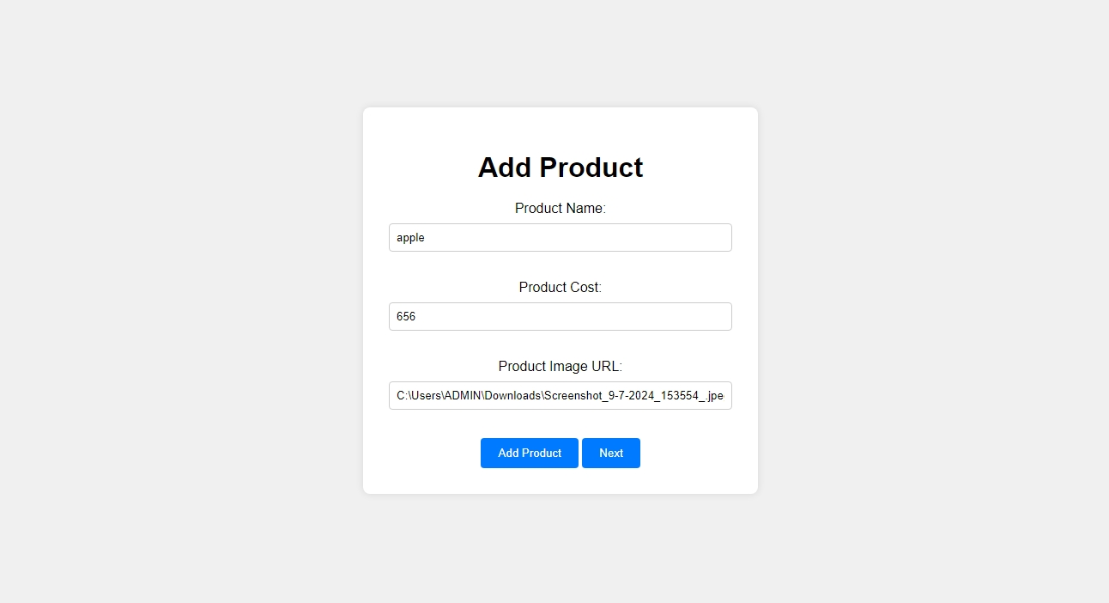

Slide 34
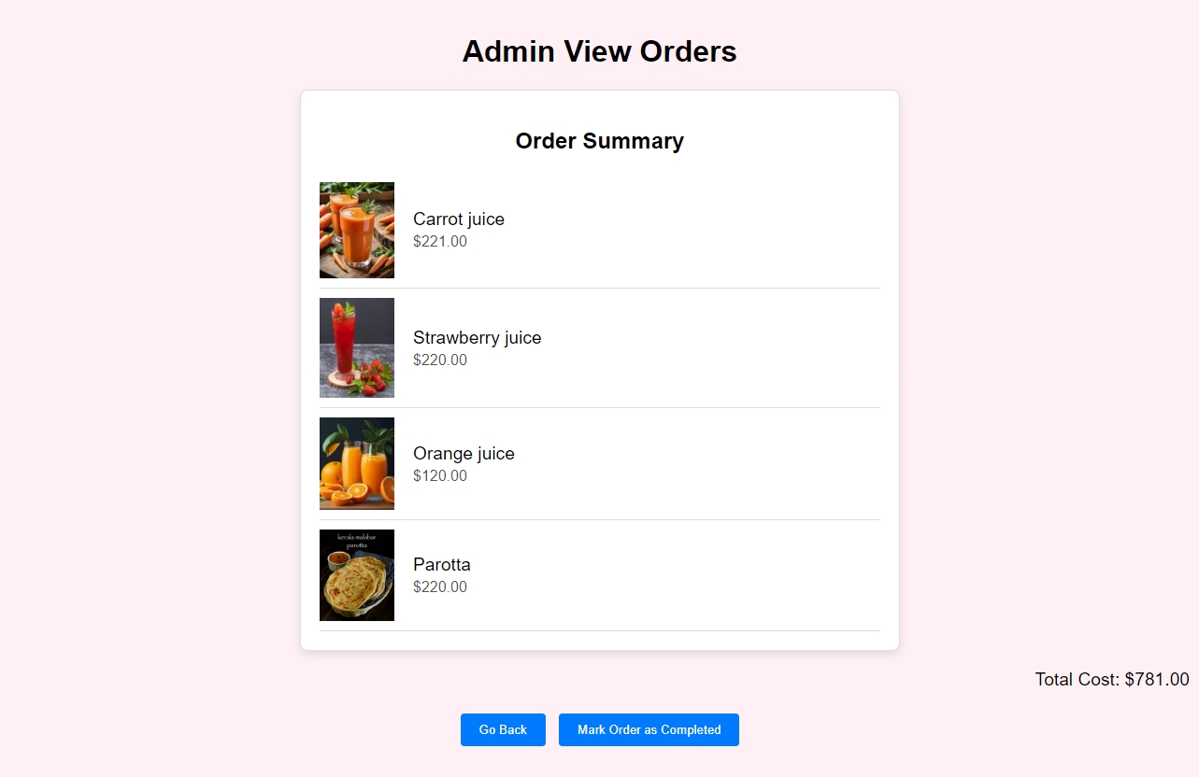

Slide 35
CONCULSION:
The Catering website project aims to revolutionize how rural caterers can reach global markets, promoting their products and preserving traditional Indian culinary heritage. By providing a robust online platform, the project empowers local developers to showcase their skills securely and efficiently through mobile devices. This initiative not only supports economic growth in rural areas but also fosters cultural exchange by highlighting the richness of Indian cuisine to a global audience.
Through this endeavor, the project seeks to uplift rural communities by providing them with tools to thrive in the digital economy while safeguarding and promoting India's diverse culinary traditions. By facilitating direct access to global markets, the Catering website aims to create a sustainable and inclusive ecosystem where traditional knowledge meets modern technology, benefiting both producers and consumers alike.

